Slide 1
DISEASES OF THE LACRIMAL SYSTEM AND ORBIT I
BY: DR. E. M. NYENZE
DATE: 10th/April/2017

Slide 2
INTRODUCTION
Most important condition: epiphora secondary to blockage in the lachrymal system.

Slide 3
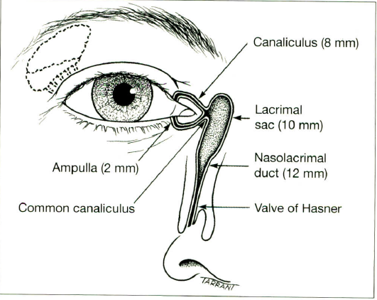
ANATOMY OF LACRIMAL SYSTEM
The lachrymal system is made of the production system and the drainage system
Main lachrymal sac is in the supero – temporal aspect of the orbit
From lachrymal gland → conjunctival cul de sac
On blinking → puncta → canaliculi → lacrimal sac → nasolacrimal duct → inferior meatus behind the nose

Slide 4
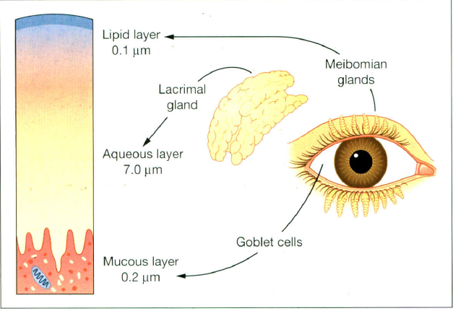
THE TEAR FILM
A new tear film is created every time one blinks.
1st layer: mucous layer produced by goblet cells
Makes the corneal surface hydrophilic
2nd layer: aqueous layer produced by the main lacrimal gland
3rd layer: lipid layer prevents evaporation and is produced by the meibomian glands.

Slide 5
DRY EYE SYNDROME
Functions of the tear film
Provides oxygen to the corneal epithelium
Anti-bacterial effect with IgA, lactoferrin and lysozyme
Making the corneal surface optically smooth
To wash away debris, dust

Slide 6
CAUSES OF DRY EYE SYNDROME/ KERATOCONJUNCTIVITIS SICCA
Sjogrens syndrome: associated with dryness of the mouth and connective tissue disorders
Meibomian dysfunction: the lipid layer production is hindered
Destruction of lacrimal gland: e.g. surgical or radio - therapeutically; the aqueous layer production is hindered
Lagophthalmos: formation of a tear film is prevented
Conjunctival scarring: goblet cell destruction
Old age: tear production is reduced in old age
Defective blinking

Slide 7
SYMPTOMS
Foreign body sensation (Esp. after wind has blown)
Dryness/ grittiness of eyes
Photophobia: the biggest function of tears is to make the corneal surface optically smooth
Blurred vision
Itchiness
Redness of eyes
Reflex excessive tearing:
The patient has a dry eye → irritation → excessive reflex tearing
Whitish frothy discharge at the corner of the eye

Slide 8
SIGNS
Blepharitis: eye lid inflammation with swelling
Epithelial erosions staining with fluorescein
Unstable tear film
Debri/ mucus plagues/ filaments staining with rose bengal
Conjunctival injection
Low tear film height

Slide 9
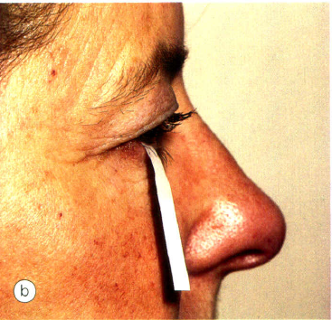
INVESTIGATION OF EYE DRYNESS
Staining tear film with fluorescein/ rose bengal
Tear film height
Tear break up time
Schirmir’s test:
Tells how much tears are produced
A filter (Schirmir’s) paper is laced in the eye
The tears should go up to 10mm in 3 minutes

Slide 10
TREATMENT
Conservative:
Avoid enviromental trigers, avoid prolonged computer use etc.
Medical:
Tear substitues (artificial tears), anti-inflammatory drops
Surgical:
Punctal occlusion (cauterization or plugging)

Slide 11
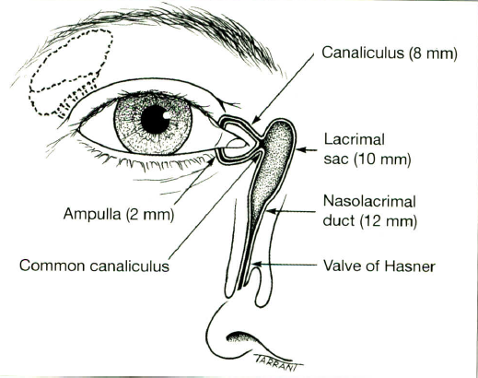
EPIPHORA
This is excessive tearing due to an obstructive cause (poor drainage), flowing down the cheeks.

Slide 12
CAUSES
Defective drainage:
Obstruction of drainage system
Malposition of punctum
Defective lacrimal pump e.g. facial nerve palsy
NOTE: Hyper - lacrimation, due to hyper - secretion from irritation is NOT considered true epiphora

Slide 13
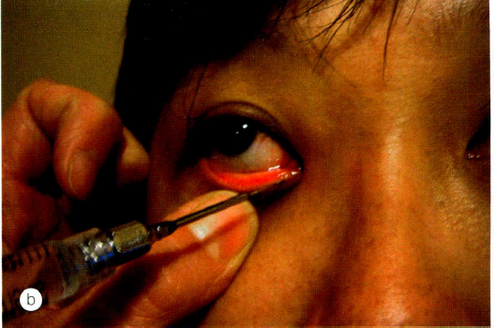
EVALUATION
Rule out hyper – lacrimation e.g. 2⁰ to infection, irritation, FB sensation
Inspection:
Cause of irritation
Eye lid malpositioning tearing
Syringing (put cannula and push water through the puncta)
This is the best way of diagnosing obstruction in the lachrymal drainage system
Dye disappearance test
Jones dye tests

Slide 14
ACQUIRED OBSTRUCTION OF DRAINAGE SYSTEM
Puntal stenosis/ atresia
Cannalicular stenosis/atresia
Naso - lacrimal duct obstruction

Slide 15
TREATMENT
Observe if not severe
Punctal dilatation if stenosed
Dacro - cystorhinostomy (DCR) in severe of nasolacrimal duct obstruction

Slide 16
CONGENITAL NASOLACRIMAL DUCT OBSTRUCTION
Presents with tearing from birth
Also has matting of lashes, frequent discharge, reflux on pressure over lacrimal region
Misnomer
Nasolacrimal duct obstruction occurs more proximally
It is also permanent unlike failure of canalizationof the valve of Hasner
Caused by delayed canalization of distal part of nasolacrimal duct (valve of Hasner)
Valve of Hasner prevents the air from going up the nasolacrimal duct

Slide 17
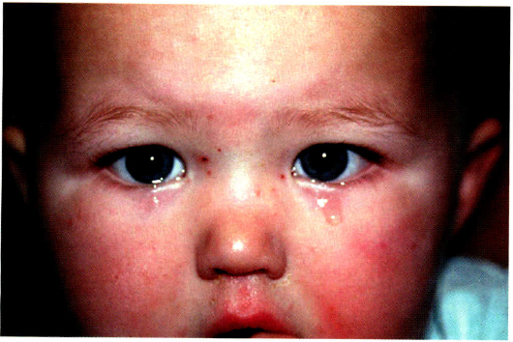

Slide 18
TREATMENT
Most of the cases resolve spontaneously before the first birthday
Massage over lacrimal sac area can help open up
Frequent secondary infections can be treated with antibiotics
Therapeutic probing and syringing (under GA) is done if problem persists beyond one year of age.

Slide 19
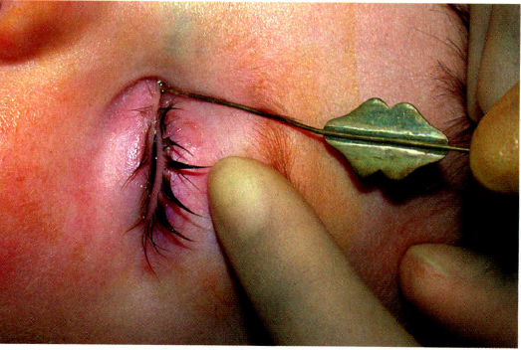

Slide 20
ORBIT I

Slide 21
ANATOMY OF THE ORBIT

Slide 22
RELATIONS OF THE ORBIT
Medial wall: nasal cavity, ethmoidal air cells, sphenoid sinus
Lateral wall: middle cranial, temporal and pterygopalatine fossae
Roof: anterior cranial fossa frontal sinus and supra orbital notch
Floor: maxillary sinus and palatine air cells

Slide 23
SURROUNDING SINUSES

Slide 24
CLINICAL EVALUATION OF ORBITAL DISEASE
History: pain, mode of onset, trauma, associated symptoms e.g. dystopia, proptosis (NB, the MC cause of proptosis worldwide is thyroid orbitopathy)
General exam
Optic nerve function tests
Visual acuity
If reduced optic nerve compression, exposure keratopathy
Color vision (red vs. green)
Pupillary reflexes (afferent pathway → optic nerve)
Vision scan
Contrast sensitivity
Inspection
Ocular motility
Ocular exam: conjunctiva, cornea, pupil, fundus

Slide 25
CONT.
Measure amount of proptosis (Hertel’s exophthalmometer, clear plastic ruler)
Palpate
Auscultate

Slide 26
THE 7 Ps OF ECALUATION OF ORBITAL DISEASES
Pain
Painful: infection, inflammation, malignancy
Painless: thyroid orbitopathy, vascular malformations
Proptosis
severe: over short period: inflammatory, malignancy
Chronic: malignancy
Dystopia: if inferior → lesion is superior; if lateral → lesion is medial
Progression
Palpation
Mass? Consistency? Fluctuant? Tender? Measurement?
Pulsation
Pulsatile: vascular malformations (AVM)
Peri – orbital changes
Ecchymosis: hemorrhage
Darkening: chronic
Shiny surface: inflammation
Pus: suppuration
Pupil
Pupillary reflexes

Slide 27
ORBITAL TUMORS
VASCULAR TUMORS/MALFORMATONS
Nero tumours
Capillary haemangiomas
Cavenous haemangiomas
Orbital varices
AV Malformations
Lymphangiomas
Haemangiopericytomas
Optic nerve gliomas
Meningiomas
Schwanomas
neurofibromas

Slide 28
Muscular tumors
Orbital fat tumors
Leimyomas
Rhabdomyosarcomas
(does not originate from extraocular muscle)
Lipomas
Atypical lipoma
sarcomas

Slide 29
Bony masses
others
Oteomas
Chondromas
Fibrous dysplasias
Osteosarcoma
Ewings sarcoma
Metastatic tumors- neuroblastoma, ca breast
Orbital cysts
Orbital pseudotumors
Sino nasal tumors extending to orbit

